Slide 1
COMP7404
Graph Learning for Multiview Clustering

Slide 2
menu

Slide 3
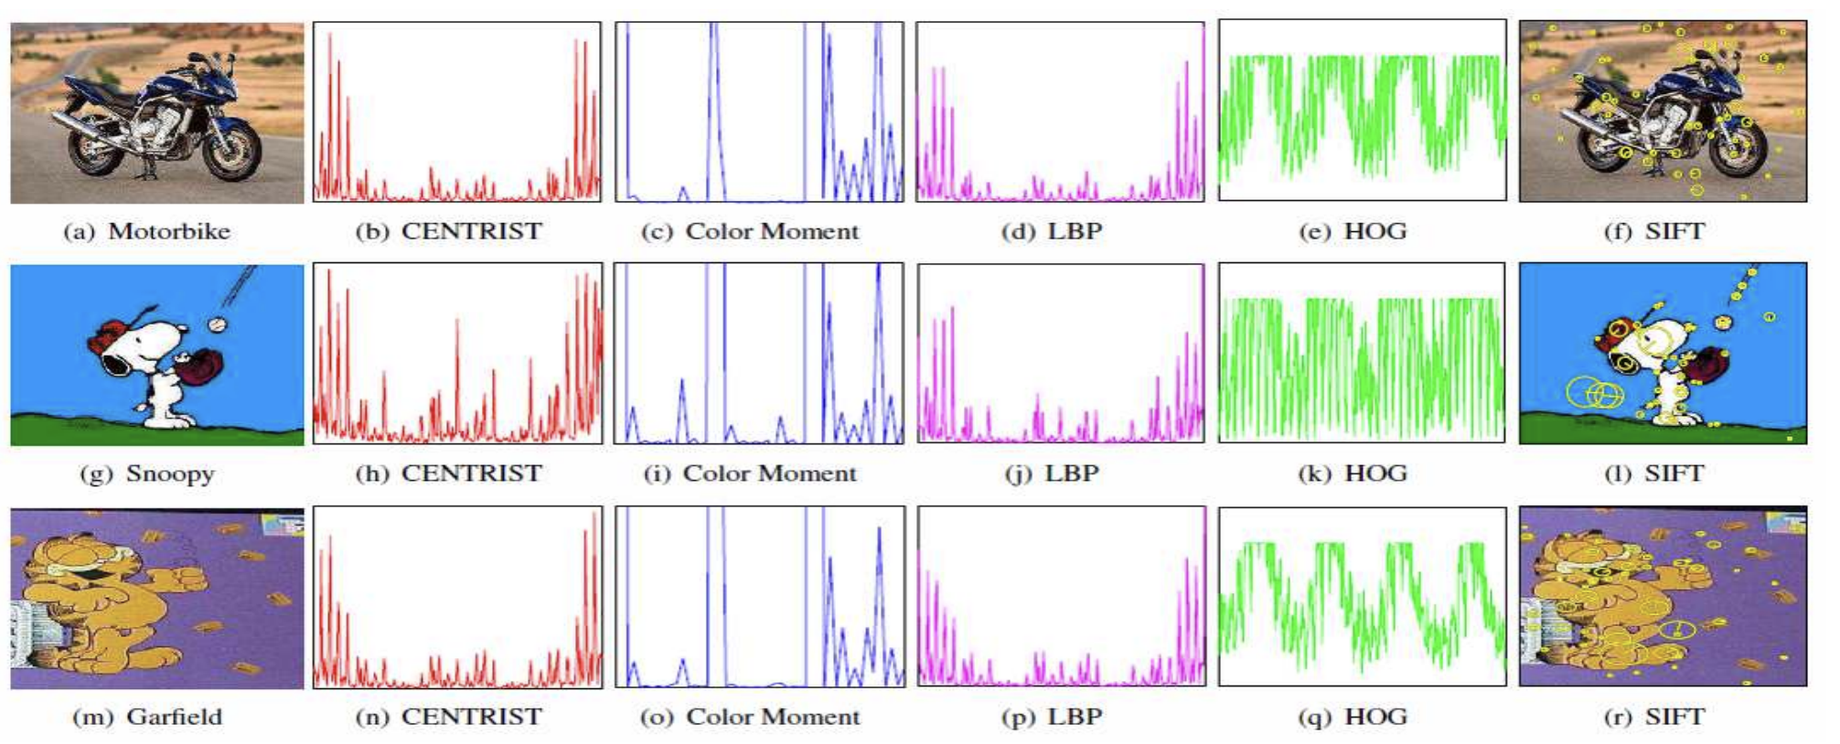
Introduction
Multi-view data
Five views (CENTRIST, ColorMoment, LBP, HOG and SIFT) on three sample images from Caltech101.

Slide 4
Background & Motivation
Traditional graph-based clustering

Slide 5
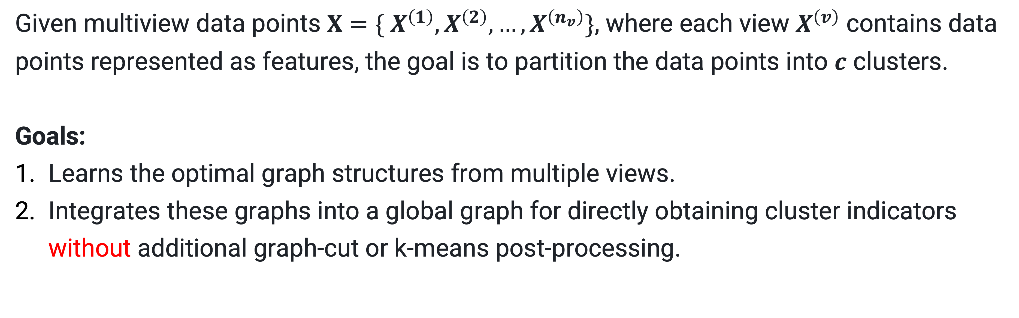
Problem Setup
Given multiview data points $X=\{ X^{\left(1\right)},X^{\left(2\right)}, …,X^{\left(n_{v}\right)}\}$, where each view $X^{\left(v\right)}$ contains data points represented as features, the goal is to partition the data points into $c$ clusters.
Goals:
Learns the optimal graph structures from multiple views.
Integrates these graphs into a global graph for directly obtaining cluster indicators without additional graph-cut or k-means post-processing.

Slide 6
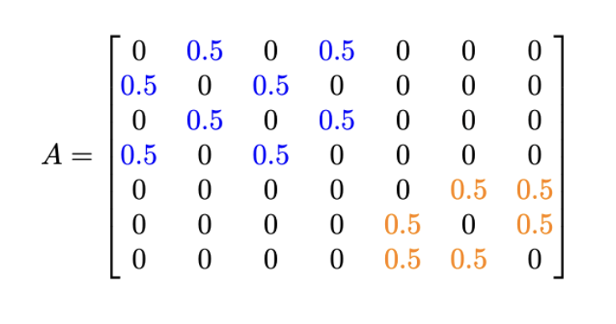
Methodology
Overview of the Proposed Method
Learning single-view graphs independently from each view.
Integrating these graphs into a global, consistent graph.
Directly obtaining cluster indicators from the global graph.
One Connected Component is One Cluster
2
5
Index: 1 2 3 4 5 6 7
Label: 1 1 1 1 2 2 2
Matrix Representation of Global Graph A
1
3
7
4
6
Learned Single View Graph 1
2
5
1
3
2
5
7
4
6
1
3
7
Learned Global Graph A
4
6
Eigenvalues: 0, 0, 1, 1, 1.5, 1.5, 2
L = D - A
Learned Single View Graph 2
Schematic of the graph learning method

Slide 7

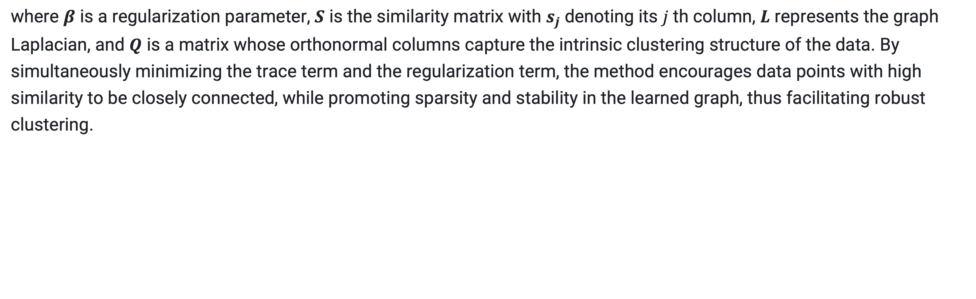
Methodology
Learning an optimal similarity graph $S$ directly from data points with a rank constraint on Laplacian matrix to ensure clear cluster structures.
.
where $β$ is a regularization parameter, $S$ is the similarity matrix with $s_{j}$denoting its $j$th column, $L$ represents the graph Laplacian, and $Q$ is a matrix whose orthonormal columns capture the intrinsic clustering structure of the data. By simultaneously minimizing the trace term and the regularization term, the method encourages data points with high similarity to be closely connected, while promoting sparsity and stability in the learned graph, thus facilitating robust clustering.

Slide 8
Implementation

Slide 9
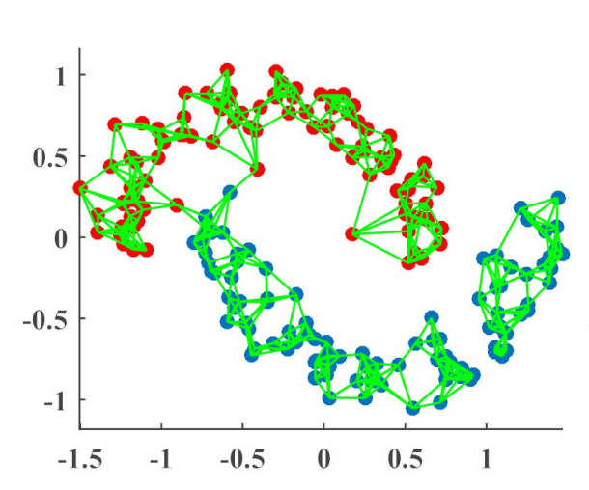
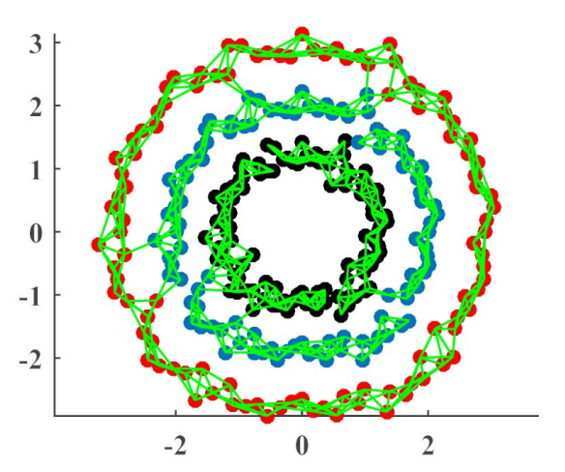
Dataset & Preprocessing
Datasets used for evaluation during development
Two moons
Three circles

Slide 10
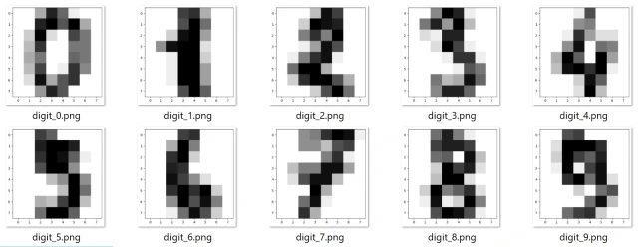
Dataset & Preprocessing
UCI digits: 16x16 hand written 0-9 grey scale images
In total 6 views:
216-D profile correlation feature
76-D Fourier-coefficient feature
64-D Karhunen–Loeve-coefficient feature
240-D intensity-averaged feature in 2 × 3 windows
47-D Zernike moment feature
6-D morphological feature
n=2000

Slide 11

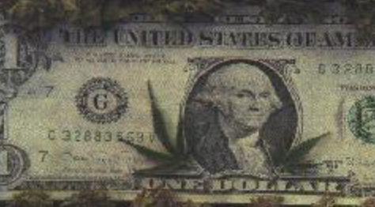
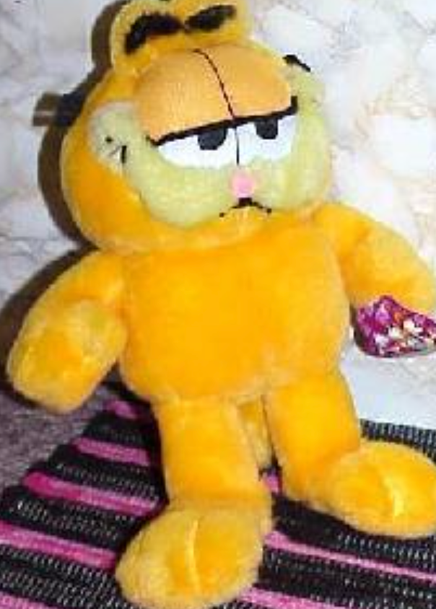
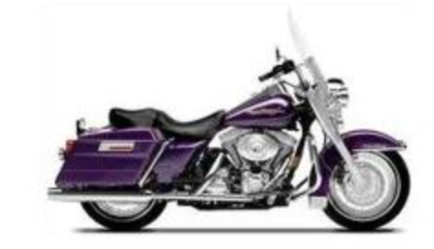
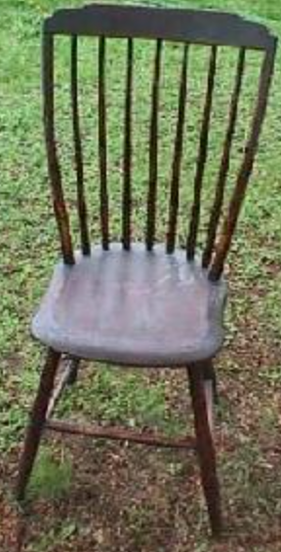

Dataset & Preprocessing
Caltech-101: image dataset has 101 categories of images
6 common class was selected for clustering
In total 6 views:
48-D Gabor feature
40-D wavelet-moment feature
254-D CENTRIST feature
1984-D HOG feature
512-D GIST feature
928-D LBP feature
Face, dollar bill, garfied,
motor bike, windsor chair, stop sign
6 classess, n = 1474

Slide 12



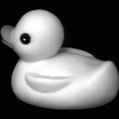
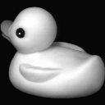
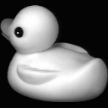
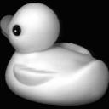
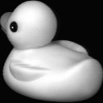
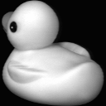
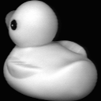










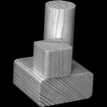
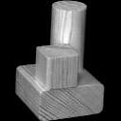
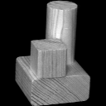
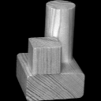
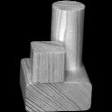
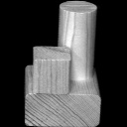
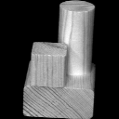
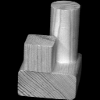
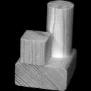
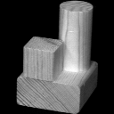


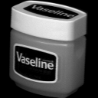
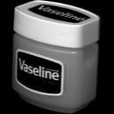

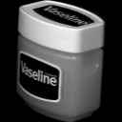
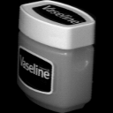
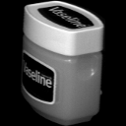
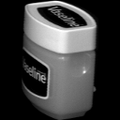
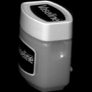
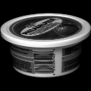
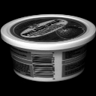
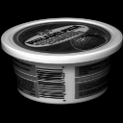
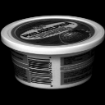

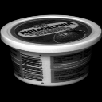

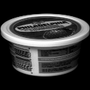


Dataset & Preprocessing
COIL-20: image dataset has 20 categories of images
Each object was placed on a motorized turntable and photographed every 5 degrees, resulting in 72 images per object. This covers a full 360-degree rotation.
In total 3 views:
3304-D LBP feature
1024-D Intensity feature
6750-D Gabor feature
toys, tools, and household items, etc.
20 classess, n = 20 * 72 = 1440

Slide 13
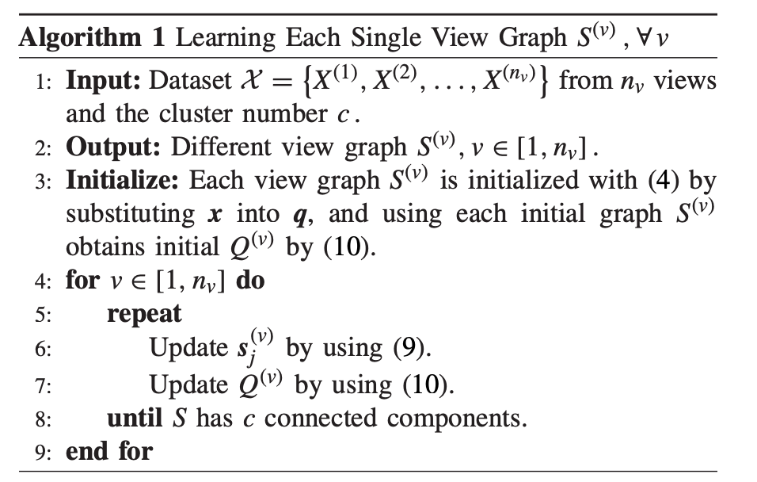
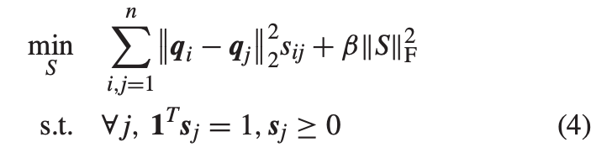
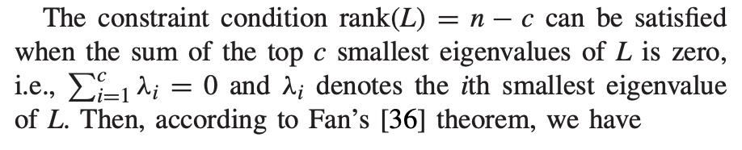
Single view graph learning
Initialize
Convergence

Slide 14
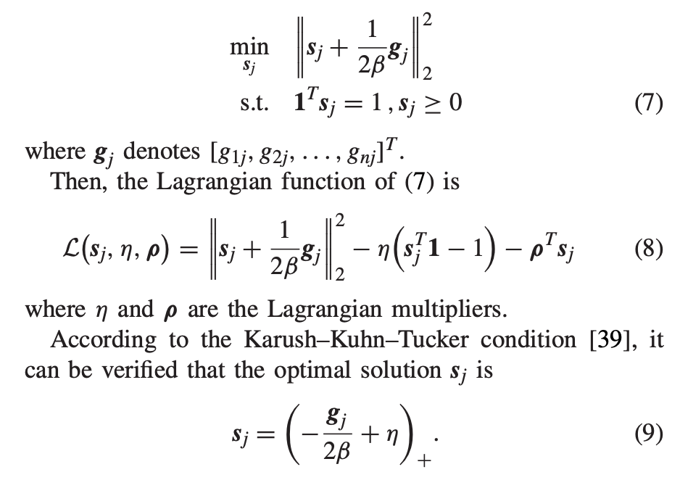
Single view graph learning
Update s

Slide 15
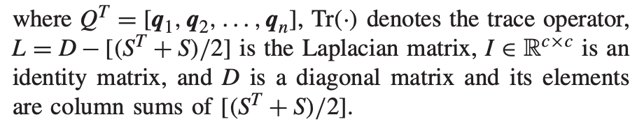
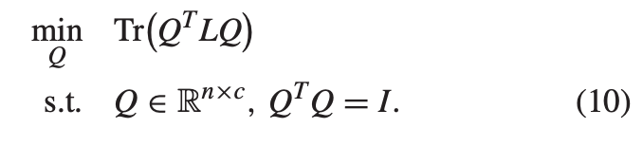
Single view graph learning
Update s

Slide 16
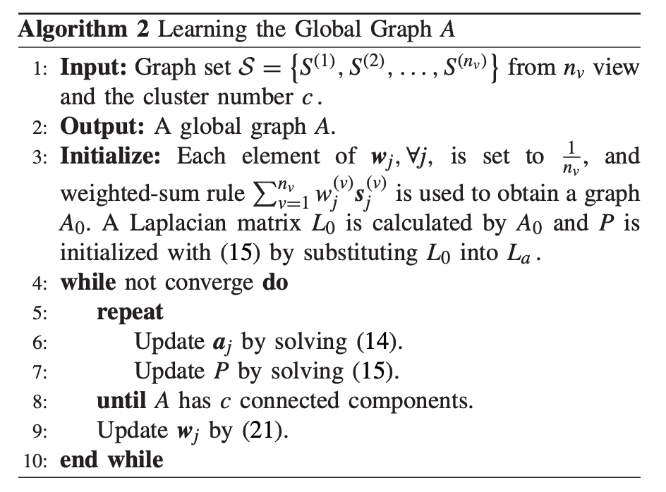
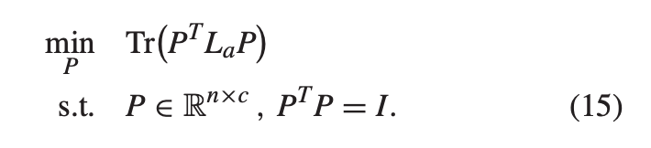
Global graph learning
Initialize

Slide 17
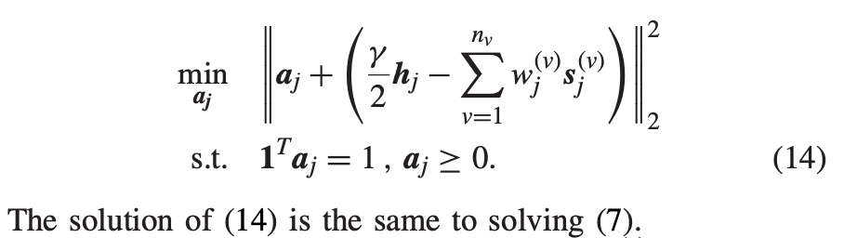
Global graph learning
Update a

Slide 18

Global graph learning
Update P

Slide 19

Global graph learning
Update w

Slide 20

Evaluation metrics
(Hungarian algorithm is used to find the best match)

Slide 21

Reproducing graphs
single view graphs
global view graph

